Slide 1
ML GROUP PROJECT
GROUP MEMBERS
KASASA LIVINGSTONE TREVOR
TUSIIME GEORGE TREVOUR

Slide 2
DATASET OVERVIEW
Shape: The dataset contains 136 rows (instances) and 20 columns (features).
Columns:
FID: Unique identifier for each record.
dname2019, d: Region or district names.
total2020, ttotal2020: Total population or another metric for the year 2020.
2010, 2016, 2017, 2018, 2020: Likely administrative references or similar.

Slide 3
X_Coord, Y_Coord: Geographic coordinates.
Shape_Area: Area measurement of the region.
PDensity, AV_Inc_Rate, Inc_Rate, AV_Tmax, AV_Tmin, AV_Rfall, AV_Popn: Various demographic, climate, and statistical indicators.
Objective
The dataset is focused on various attributes of different districts or regions (e.g., population, geography, climate, and socio-economic indicators).
It can be used to gain insights into regional characteristics, identify patterns or anomalies, and build predictive models to understand relationships between these factors.
The dataset's applications can span from urban planning and resource allocation to environmental impact assessment and socio-economic studies.

Slide 4
DATA PRE-PROCESSING ACTIVITIES
Handling Missing Values:
Check for missing values in each column (e.g., using df.isnull().sum()).
Strategies to handle missing data, such as imputation (using mean, median, mode), deletion of rows/columns but based on our dataset there were no missing values hence the methods were inapplicable
Handling Categorical Data:
We identified columns containing categorical variables such as district names((dname2019 and d columns)). And we applied label encoding to convert categorical variables into numerical format suitable for machine learning algorithms.

Slide 5
Scaling and Normalization:
Numerical features were scaled to a similar range to prevent certain features from dominating the model.
Min-Max scaling technique was used on numerical features.
Feature Selection
Evaluate feature importance to identify relevant features for modeling.
Remove irrelevant or redundant features that may not contribute significantly to the predictive task.
We also checked for duplicate values to avoid dealing with redudant data. Though based on our dataset there were no duplicate values

Slide 6
DATA CLASSIFICATION
We performed data classification using different classifiers like the Random Forest Classifier, Artificial Neural Network classifier, Logistic Regression classifier, Linear SMV classifier and Decission Tree classifier where we trained each classifier and determineed its evaluation metrics that is Accuracy, Recall, Precission, and F1-score.
We used these classification algorithms available in Python to predict categorical variables such as 'dname2019' or 'd' based on other features

Slide 7
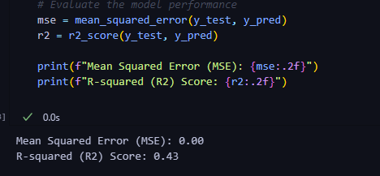
PREDICTIVE MODELLING
Here we built a predictive model using Linear regression. Where we separated the target variable (total2020) and predictor variables (features) for modeling.
We split the data into training and testing sets and we initialised the regression model, we evaluated the model performance to detremine the Mean Squared Error (MSE) and R-squared (R2)

Slide 8
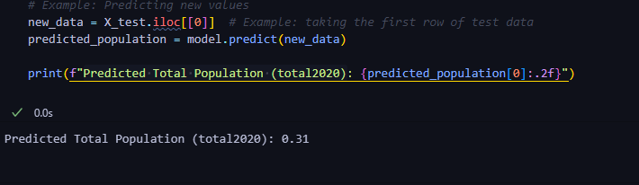
then used it predict the Predicted Total Population (total2020). And this helped us to confirm yhe our model was working

Slide 9
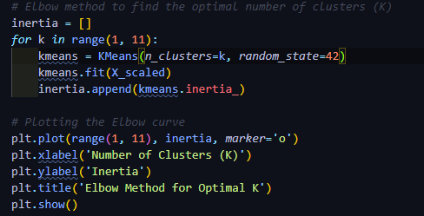
CLUSTERING
We used K-means clustering to perform clustering on the dataset using python libraries.

Slide 10
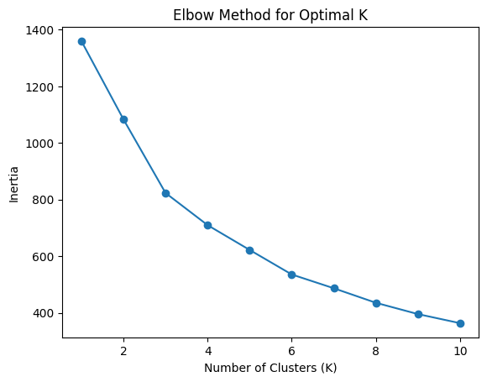
We customized the feature selection, standardization, and visualization based on the dataset and clustering objectives.
We used Elbow method to find the optimal number of clusters (K). And we ploted the elbow curve which helped us determine the optimal k.

Slide 11
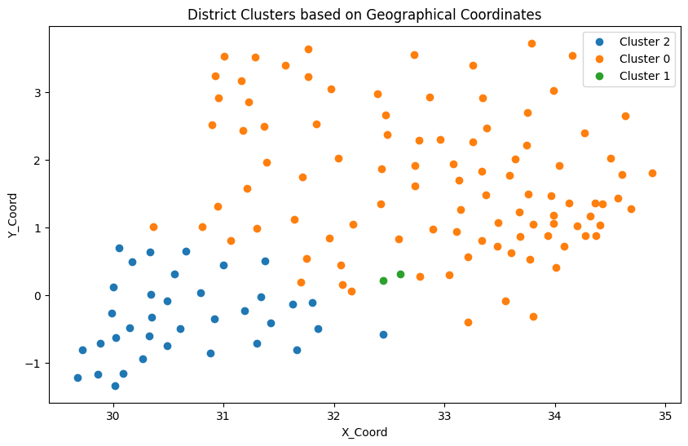
We visualised the clusters based on geographical coordinates using scatter plots to understand the grouping of districts based on feature similarity.

Slide 12
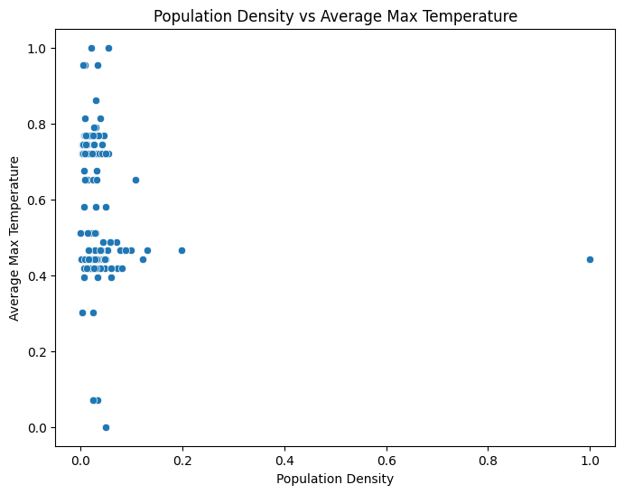
EXPLORETORY DATA ANALYSIS
We created scatter plots to explore the relationships between variables, such as population density (PDensity) and climate attributes (AV_Tmax, AV_Tmin, AV_Rfall).

Slide 13
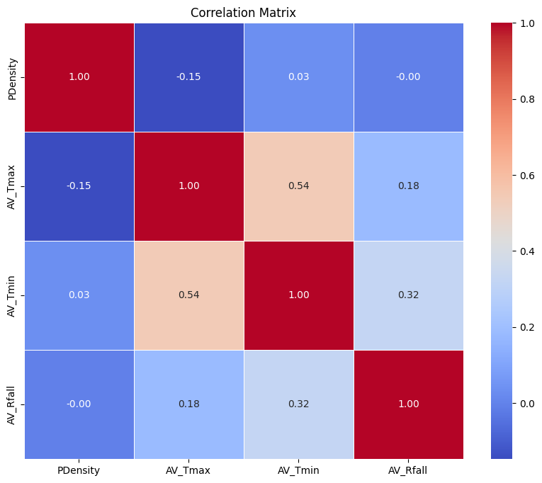
We ploted the computed the the correlation matrix of the data exploretiry variables we used and plotted their heat map.

